Slide 1

Interact&Learn
Online Education better than classroom teaching
Team Celestial - Aman Singh - Akash Saxena - Kumari Palak - Shantanu Shukla

Slide 2

What is the need of our Platform?
Boring Classes Online
Low-Bandwidth
Missing Individual attention
Video lectures and online classes are boring because they don't provide interactivity and creativity to students
Online classes and video lectures require good bandwidth . Your learning is hindered because of low-bandwidth
Online educational platforms lack environment that keeps students motivated and happy to learn.

Slide 3

What is our Solution?
A platform providing interactivity of a classroom in a pre-recorded video lectures at a very low bandwidth.

Slide 4
Our Approach
Focus on everyone and setting the right environment for optimum learning.
Interactive Videos, at a very low bandwidth.
Interactive classrooms allowing user involvement in pre-recorded lectures
Maximum Quality Content at Minimum Data Consumption.
Personalized timeline tailored just for user.
A.I powered system that makes pair/peer group online according to student’s learning speed and performance to have constant motivation for learning.
A.I powered doubt solver for any queries while watching the course

Slide 5
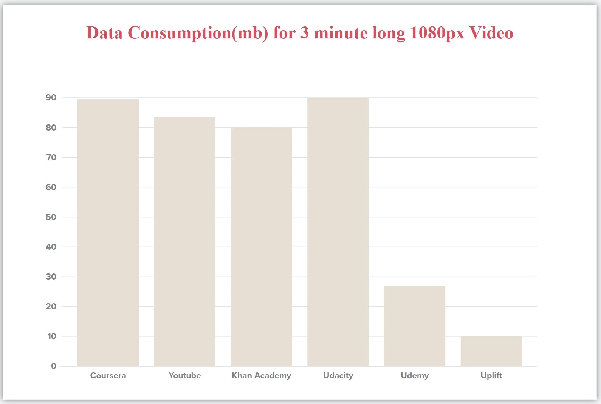
88 mb
90 mb
82.5 mb
80.5 mb
Our Platform, using new tutorial format.
28 mb
10 mb

Slide 6
How are We Recording Tutorials (A new video format)
We want to reinvent the video format for explaining concepts, where users can interact with the video, that is like a video game and not just see it like a movie.
If we investigate the basics of video of any format, they record pixels and then render them.
But if record events (mouse move, click, scroll) instead of pixels.. and instead of drawing each pixel on any hardware, we redo those events. We can make an interactive video.. where students can change the things that the instructor is doing and see different outcomes of his creativity.
3 . Creating a video will be super easy. There’s no downloading, exporting or uploading involved.
4. You simply open our web-based editor, click RECORD, and start talking while you teach on our web-based application.
5. When someone watches your screencast, we recreate exactly what you did when you recorded it (in the same environment). This enables the viewer to copy, edit or run the tutorial, in the way they want.
6. Since we are not recording pixels, so this approach allowed us, to record in a very small size, and have interactivity

Slide 7
Competitive Advantages
1. Online education at a very low bandwidth, that will be almost 10 times less than the best optimised educational platform.
2. A revolutionary video format, that focuses on promoting creativity of the student, unlike all the online educational platform in human history till date.
3.UI/UX focued on making features easy to use for both parties
4.Only things they need is a browser to use every feature we offer from making a lecture to watching one to doubt solving and more
5.Can be used of colleges or by freelancers
6.We provide a environment to keep students engaged and motivated

Slide 8
Advantages
Peer to Peer learning
Personalized Timeline
Problem Solver
After assessing you for first 5% of the course, our platform will form a group of 5 people including you who are just around your level and then make a leaderboard just for the group. In this way you will be able to compete with other students and have meaningful discussions with them while learning. This will also ensure that you don't lose motivation half-way through the course and hence improving overall learning
Our platform will monitor your progress for starting 5% of the course and will estimate the amount of time you will take in completing the course on the basis of available data. Platform will also show you your daily targets depending on your timeline, making sure that your daily targets never get too hard or too time consuming to complete.
You can also reset your timeline at any point during the course if daily targets become too hard for you. You can also set a custom deadline for yourself and our platform will adjust your daily targets according to that deadline.
Normally when a user asks a question then it takes about 24 hours or more for someone to reply and even then, the reply depends on the popularity of the course. But in our case, if a user asks a question, then we will try to provide our user with answer of some already solved doubt which is closest to the current doubt and if our user is not satisfied with the solution then an instructor will solve the doubt. This will make the doubt solving process faster
.

Slide 9
Tech Stack
ReactJS
NodeJS
MongoDB
ExpressJS
Python
Heroku

Slide 10
—SOMEONE FAMOUS
Thanks!
“Tell me, I forget,
Teach me, I may remember,
Involve me, I learn”

